Slide 1
HOW TO WRITE PROPER

Slide 2

Introduction
Communicating clearly & with authority is a vital life skill

Slide 3
THIS WEEK’S AIM
How can I construct, clear and concise, written academic arguments?
Understand what it means to communicate with clarity. Although will focus on the academic style of writing, the basic tenets can be applied to any form of authoritative writing (e.g., emails, proposals, CVs and Linked in Profiles).

Slide 4
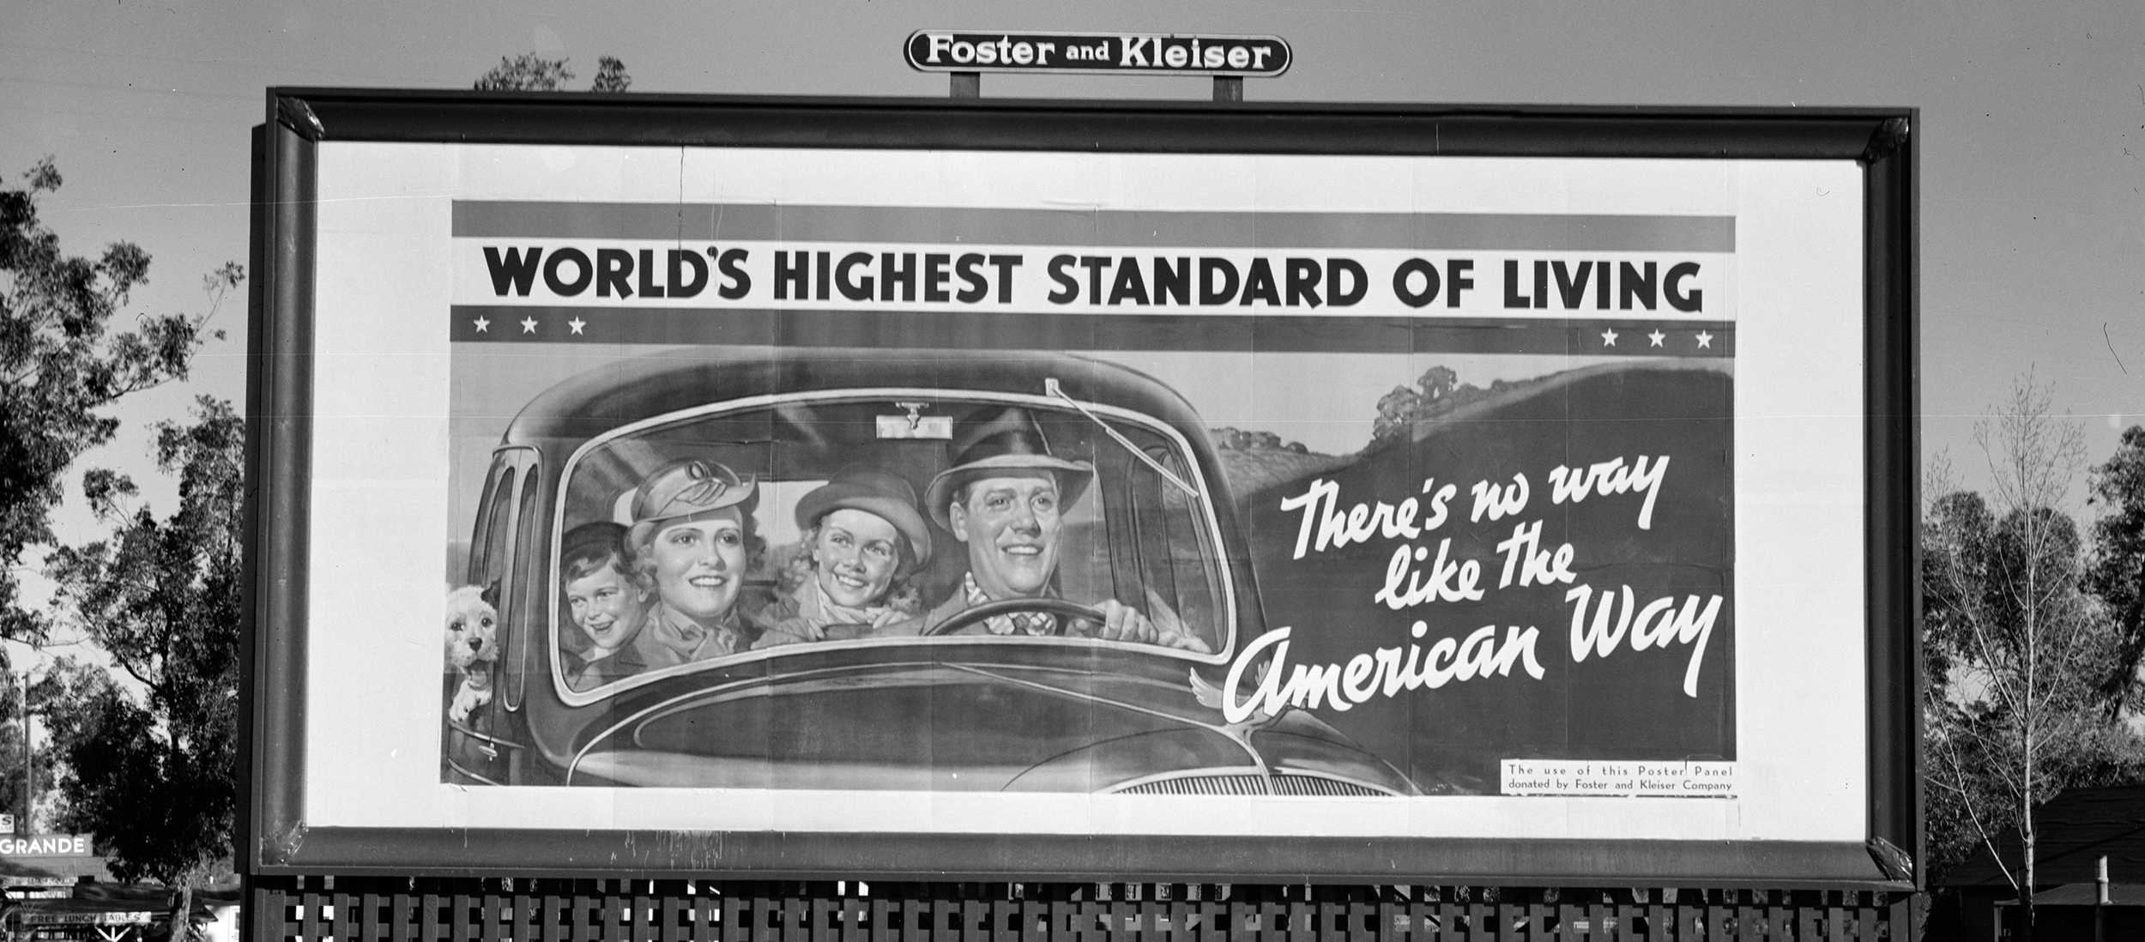
STYLES OF WRITING
Primarily, in your day-to-day life, you will be exposed to different flavours of journalistic writing (e.g. news, blogs and advertising copy).
Notes:
Styles of Writing
You may or may not be aware, that there are different styles of writing. Primarily, in your day-to-day life, you'll be exposed to different flavours of journalistic writing (e.g, news, blogs and advertising copy). This styled of writing uses short punchy sentences and paragraphs. The goals is to draw the readers in with attention grabbing titles, images and headlines. You'll often find that the paragraphs and sentences used are short and punchy - to quickly convey information. For instance, it is common to see one sentence paragraphs
Academic, writing on the other hand, consists of longer paragraphs. The reason for this is statements made must be underpinned by evidence. Let's explore this idea by first considering paragraphs, then moving

Slide 5
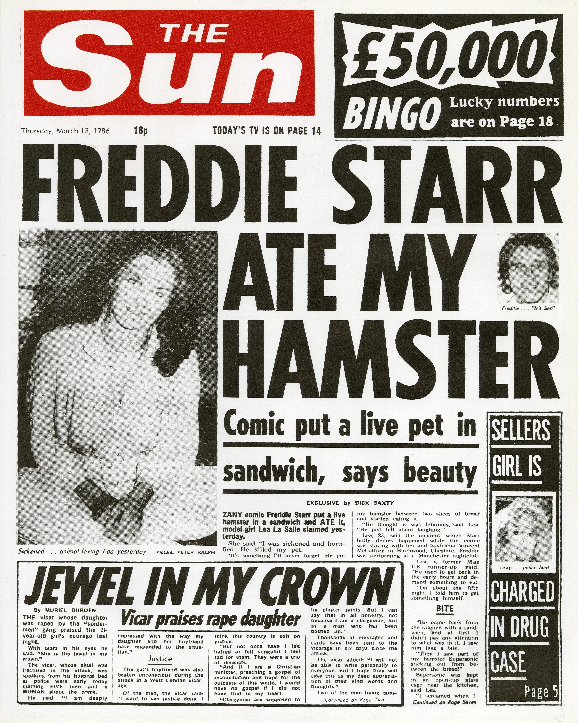
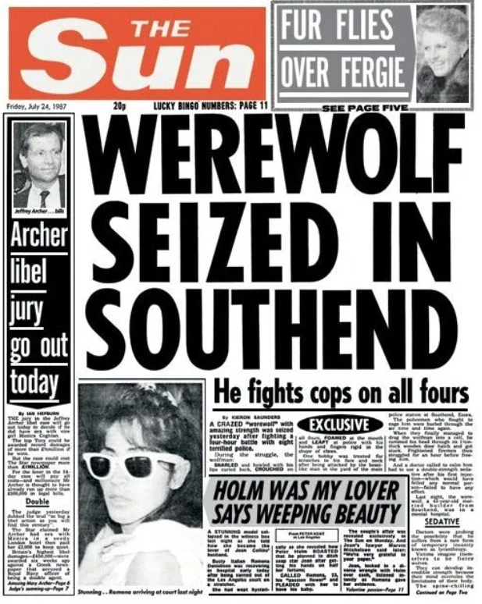
STYLES OF WRITING
This styled of writing uses short punchy sentences and paragraphs.
The goals is to draw the readers in with attention grabbing titles, images and headlines. You'll often find that the paragraphs and sentences used are short and punchy - to quickly convey information.
Notes:
Styles of Writing
You may or may not be aware, that there are different styles of writing. Primarily, in your day-to-day life, you'll be exposed to different flavours of journalistic writing (e.g, news, blogs and advertising copy). This styled of writing uses short punchy sentences and paragraphs. The goals is to draw the readers in with attention grabbing titles, images and headlines. You'll often find that the paragraphs and sentences used are short and punchy - to quickly convey information. For instance, it is common to see one sentence paragraphs
Academic, writing on the other hand, consists of longer paragraphs. The reason for this is statements made must be underpinned by evidence. Let's explore this idea by first considering paragraphs, then moving

Slide 6
STYLES OF WRITING
For instance, it is common to see one sentence paragraphs:
As Australia prepares to begin the rollout of Covid-19 vaccines, state health departments, including SA Health and Queensland Health, were unable to post.
Notes:
Styles of Writing
You may or may not be aware, that there are different styles of writing. Primarily, in your day-to-day life, you'll be exposed to different flavours of journalistic writing (e.g, news, blogs and advertising copy). This styled of writing uses short punchy sentences and paragraphs. The goals is to draw the readers in with attention grabbing titles, images and headlines. You'll often find that the paragraphs and sentences used are short and punchy - to quickly convey information. For instance, it is common to see one sentence paragraphs
Academic, writing on the other hand, consists of longer paragraphs. The reason for this is statements made must be underpinned by evidence. Let's explore this idea by first considering paragraphs, then moving

Slide 7
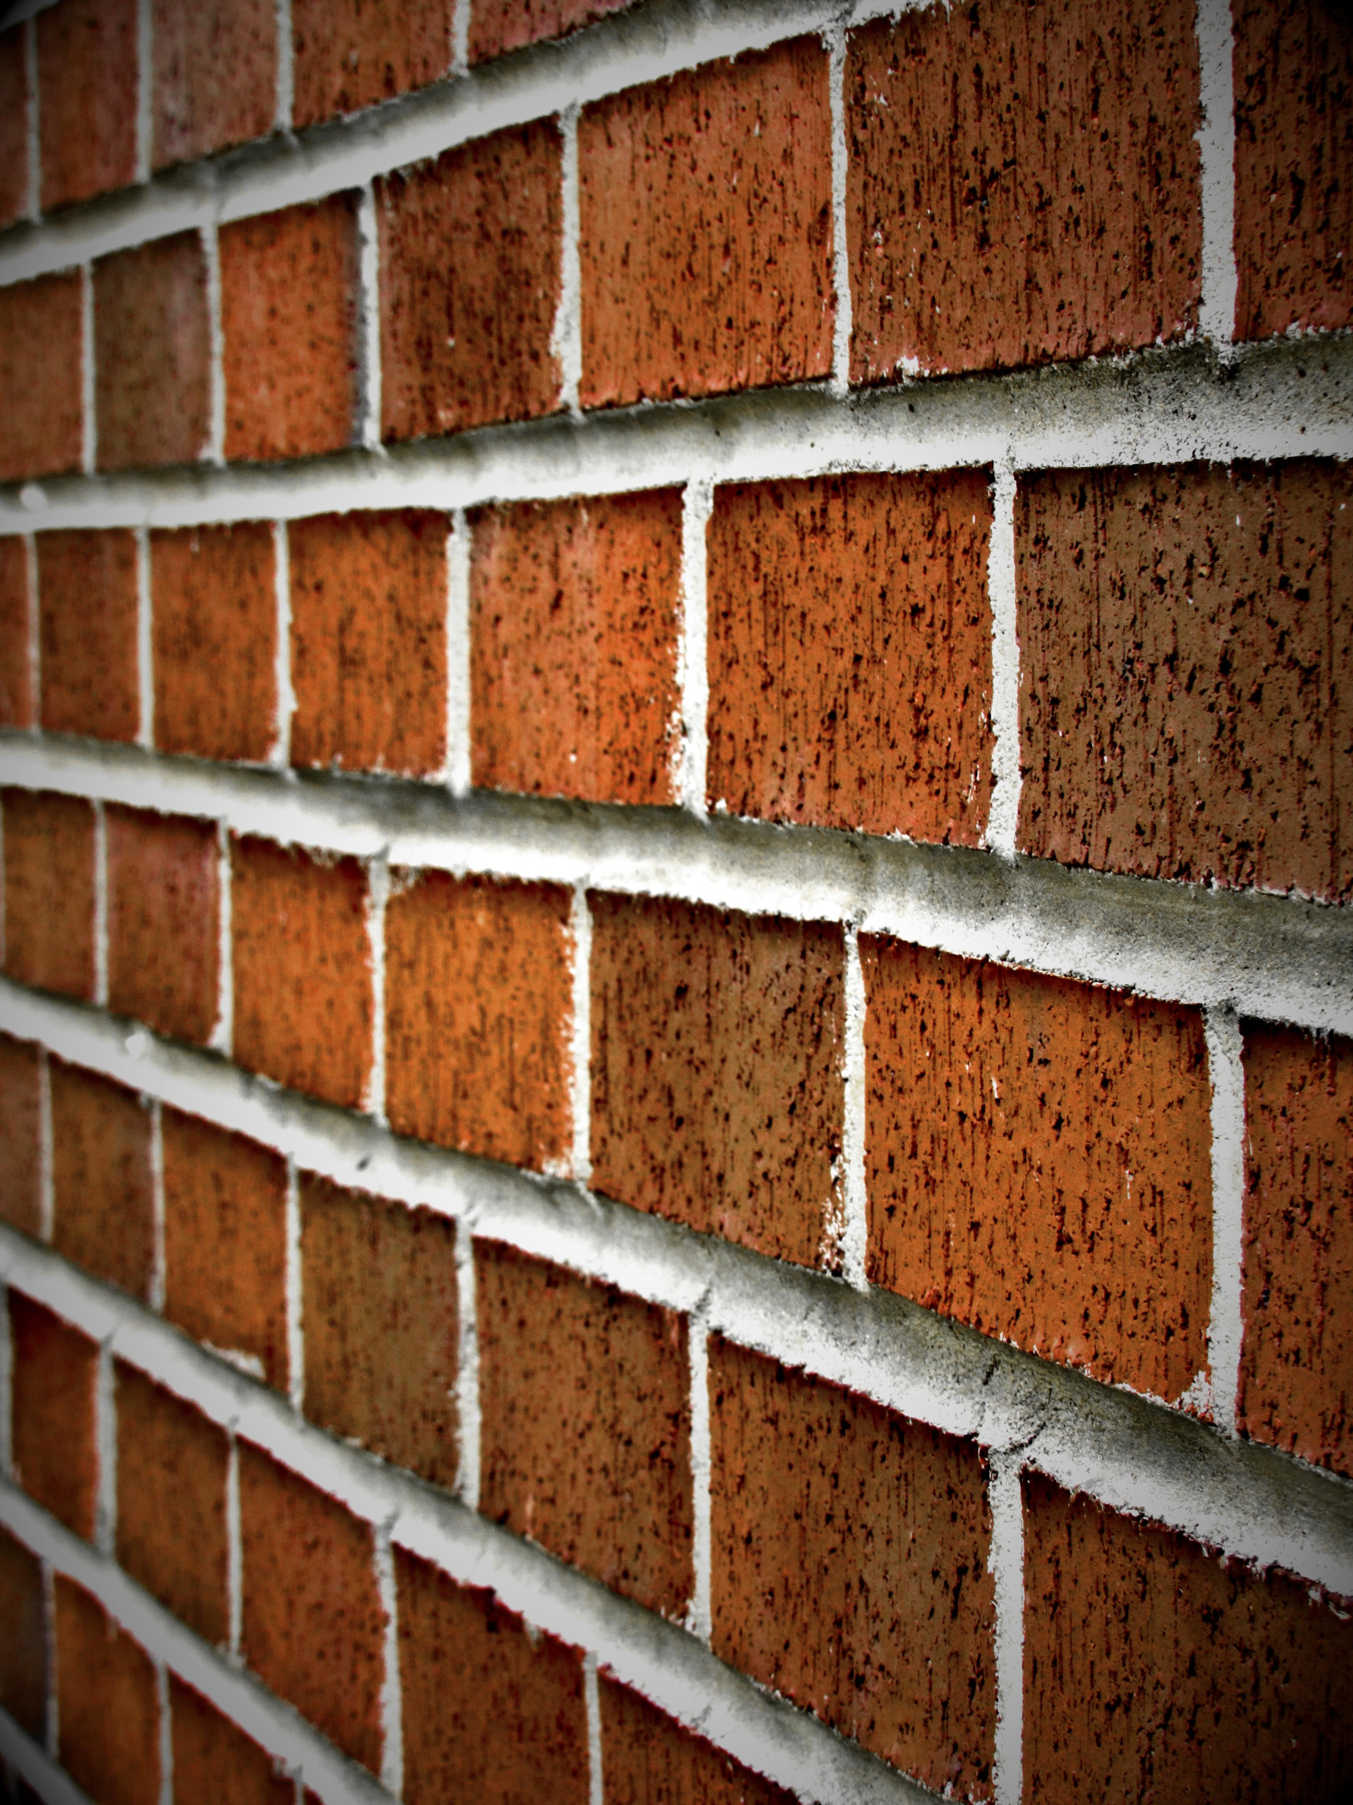
THE PARAGRAPH
If you liken writing, to building a house - paragraphs would be the building bricks. When crafting your writing they act as the key unit of composition. So, you may have gathered that the paragraph is one of the most important tools in your writing arsenal.
.
Notes:
The Paragraph
If you liken writing, to building a house - paragraphs would be the building bricks. When crafting your writing they act as the key unit of composition. So, you may have gathered that the paragraph is one of the most important tools in your writing arsenal. However, I have noticed that many people make some fundamental mistakes; however, this can easily be avoided. Unlike much of the English language, paragraphs follow a very simple rule: Each paragraph consists of a single idea.

Slide 8

THE PARAGRAPH
Many people make some fundamental mistakes; however, this can easily be avoided. Unlike much of the English language, paragraphs follow a very simple rule:
Each paragraph consists of a single idea.
Notes:
The Paragraph
If you liken writing, to building a house - paragraphs would be the building bricks. When crafting your writing they act as the key unit of composition. So, you may have gathered that the paragraph is one of the most important tools in your writing arsenal. However, I have noticed that many people make some fundamental mistakes; however, this can easily be avoided. Unlike much of the English language, paragraphs follow a very simple rule: Each paragraph consists of a single idea.

Slide 9
THE PARAGRAPH
The concept that each paragraph represents a single - self contained idea is a fundamental truth of all writing styles.
This idea is captured in a single sentence, normally at the start paragraph, known as the topic sentence.
If you were writing informally (e.g., blogging or and email). A topic sentence can stand alone as a single sentence paragraph.
However, the paragraphs that underpin your main academic arguments, we need to take things a little further.
Notes:
The Paragraph
If you liken writing, to building a house - paragraphs would be the building bricks. When crafting your writing they act as the key unit of composition. So, you may have gathered that the paragraph is one of the most important tools in your writing arsenal. However, I have noticed that many people make some fundamental mistakes; however, this can easily be avoided. Unlike much of the English language, paragraphs follow a very simple rule: Each paragraph consists of a single idea.

Slide 10
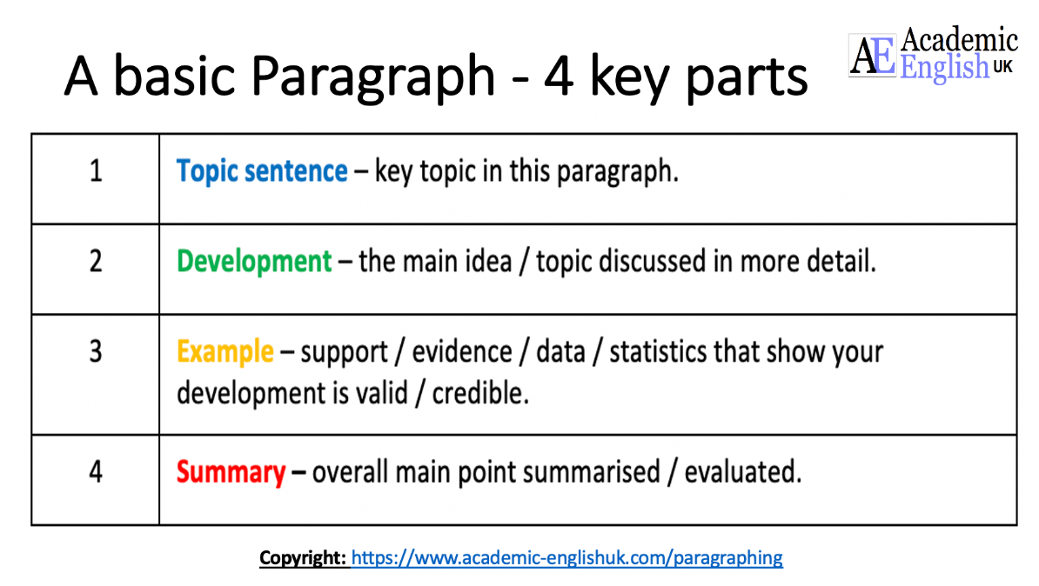
academic-englishuk.com/paragraphing/
UNIVERSITY OF NEW ENGLAND, 2023. Academic paragraphs [viewed 28 June 2023]. Available from: https://aso-resources.une.edu.au/academic-writing-course/paragraphs/academic-paragraphs/

Slide 11
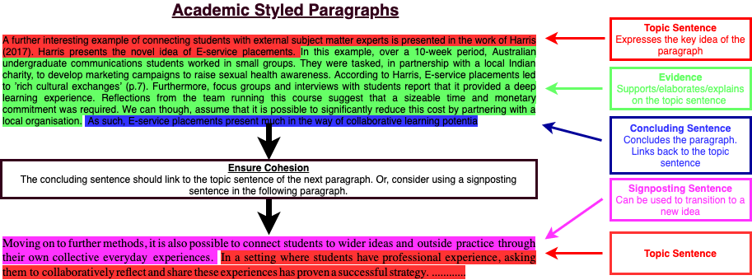
THE PARAGRAPH
Notes:
We've already established that a paragraph, as a minimum, should have a topic sentence. However, in academic writing it is generally not enough for a topic sentence to stand alone by itself - this is especially the case if the paragraph is important. Academic paragraphs should consist of three key parts:
Topic sentence - expresses the key idea
Evidence - Supports/elaborates/explains the topic sentence
Concluding Sentence - concludes the paragraph, should link back to the topic sentence
While each paragraph should make a stand alone point, there should be a logical flow between paragraphs. This is achieved through linking the concluding sentence to the topic sentence of the next paragraph; or, if the wider idea is transitioning, you can use a signposting sentence before the topic sentence.
A clear sign that you are writing cohesive paragraphs is by reading the first sentence of each paragraph in isolation. If there is a clear flow you are achieving a very high level of writing.

Slide 12
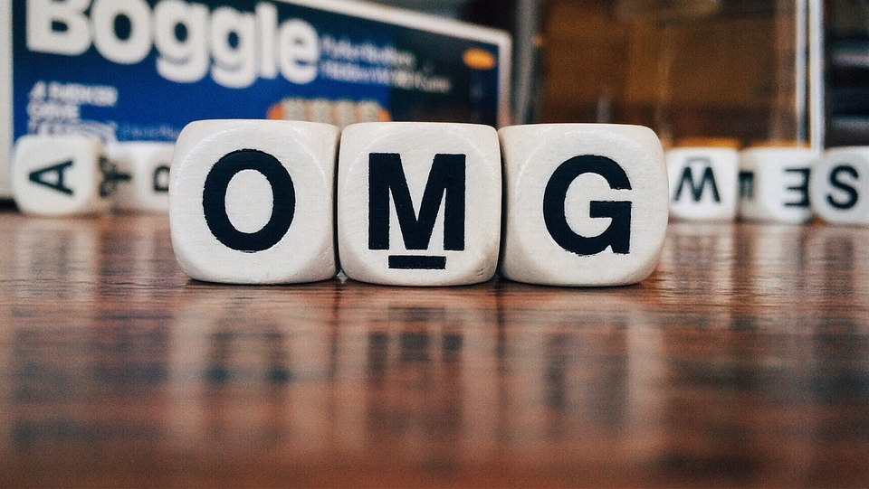
LANGUAGE STYLE
It is important we consider the audience we are writing for and adjust our language accordingly. However, that does not mean devolve into using text speech. Try to strike a balance between slightly entertaining and factual.
Notes:
Language Style
It's important we consider the audience we are writing for and adjust our language accordingly. For instance, these notes are fairly informal as they cater to a student audience. However, that does not mean I devolve into using text speech. Nonetheless, I try to strike a balance between slightly entertaining and factual.
With regards to academic writing many people make the mistake of trying to use, what they consider, sophisticated language. However, simplicity and clarity is key. All that matters is your underlying argument and supporting evidence. Flavoursome, pretentiousness or inflated language can cloud the underlying purpose of your work. With the idea of simplicity in mind, you can't go too wrong by following George Orwell's rules of writing:
Never use a metaphor, simile, or other figure of speech which you are used to seeing in print.
Never use a long word where a short one will do.
If it is possible to cut a word out, always cut it out.
Never use a foreign phrase, a scientific word, or a jargon word if you can think of an everyday English equivalent.
George Orwell's writing rules - I've abbreviated these so
Do not use contractions (e.g. don't, can’t)
Use adverbs and adjectives sparingly - I don't care that you think your project was a great success. Or, that a methodology is a vital part of a research project.
Avoid chatty speech and language - So, basically, I don't want to see this sort of writing, yea!

Slide 13
LANGUAGE STYLE
With academic writing many people make the mistake of trying to use, what they consider, sophisticated language. However, simplicity and clarity is key. All that matters is your underlying argument and supporting evidence.
Flavoursome, pretentiousness or inflated language can cloud the underlying purpose of your work.
Notes:
Language Style
It's important we consider the audience we are writing for and adjust our language accordingly. For instance, these notes are fairly informal as they cater to a student audience. However, that does not mean I devolve into using text speech. Nonetheless, I try to strike a balance between slightly entertaining and factual.
With regards to academic writing many people make the mistake of trying to use, what they consider, sophisticated language. However, simplicity and clarity is key. All that matters is your underlying argument and supporting evidence. Flavoursome, pretentiousness or inflated language can cloud the underlying purpose of your work. With the idea of simplicity in mind, you can't go too wrong by following George Orwell's rules of writing:
Never use a metaphor, simile, or other figure of speech which you are used to seeing in print.
Never use a long word where a short one will do.
If it is possible to cut a word out, always cut it out.
Never use a foreign phrase, a scientific word, or a jargon word if you can think of an everyday English equivalent.
George Orwell's writing rules - I've abbreviated these so
Do not use contractions (e.g. don't, can’t)
Use adverbs and adjectives sparingly - I don't care that you think your project was a great success. Or, that a methodology is a vital part of a research project.
Avoid chatty speech and language - So, basically, I don't want to see this sort of writing, yea!

Slide 14
Do not use contractions (e.g., don't, can’t)
Use adverbs and adjectives sparingly I don't care that you think your project was a great success. Or, that a methodology is a vital part of a research project.
Avoid chatty speech and language
Notes:
Do not use contractions (e.g. don't, can’t)
Use adverbs and adjectives sparingly I don't care that you think your project was a great success. Or, that a methodology is a vital part of a research project.
Avoid chatty speech and language

Slide 15
WAIT... What?
adjectives
They live in a beautiful house. They have a beautiful house
adverbs
He swims well.
He ran quickly.
She spoke softly.
Notes:
adjectives - a word naming an attribute of a noun, such as sweet, red, or technical.

Slide 16
FIGURE OF SPEECH
METAPHORS include: raining cats and dogs
SIMILE: He looks like a fish out of water or She slept like a log
Simile
Metaphor
Personification
Paradox
Understatement
Metonymy
Apostrophe
Hyperbole
Synecdoche
Circumlocution
Pleonasm
Irony
Pun
Euphemism
Epigram
Oxymoron
Antithesis
Litotes
Alliteration
Onomatopoeia
LITERARYDEVICES.NET., 2020. Figure of Speech - Examples and Definition of Figure of Speech [viewed 17 March 2021]. Available from: https://literarydevices.net/figure-of-speech/
‌
Notes:
METAPHORS include: raining cats and dogs
SIMILE: He looks like a fish out of water or She slept like a log
Simile
Metaphor
Personification
Paradox
Understatement
Metonymy
Apostrophe
Hyperbole
Synecdoche
Circumlocution
Pleonasm

Slide 17
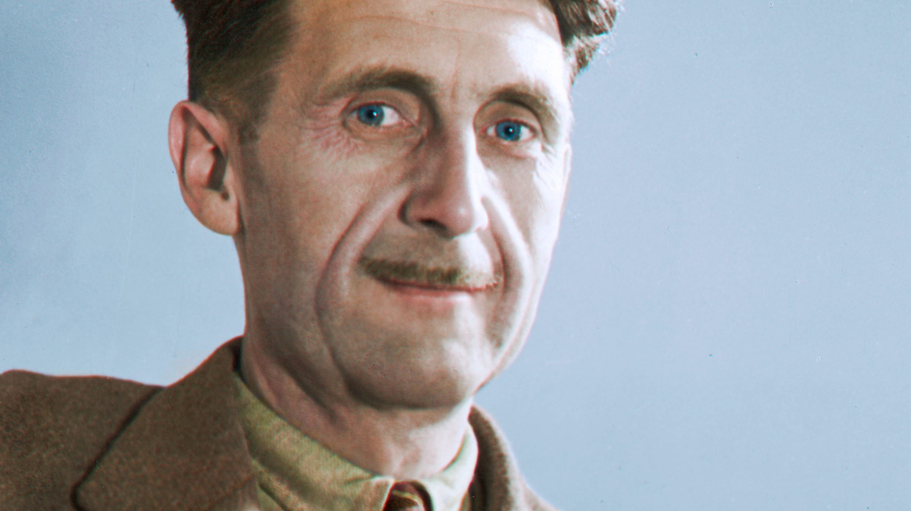
GEORGE ORWELL'S RULES OF WRITING
orwellfoundation.com

Slide 18
GEORGE ORWELL'S RULES OF WRITING
Never use a metaphor, simile, or other figure of speech which you are used to seeing in print.
Never use a long word where a short one will do.
If it is possible to cut a word out, always cut it out.
Never use the passive where you can use the active.
Never use a foreign phrase, a scientific word, or a jargon word if you can think of an everyday English equivalent.
Break any of these rules sooner than say anything outright barbarous.
ORWELL, G., 1946. Politics and the English Language. Available from: http://www.public-library.uk/ebooks/72/30.pdf
‌
Notes:
Never use a metaphor, simile, or other figure of speech which you are used to seeing in print.
Never use a long word where a short one will do.
If it is possible to cut a word out, always cut it out.
Never use the passive where you can use the active.
Never use a foreign phrase, a scientific word, or a jargon word if you can think of an everyday English equivalent.
Break any of these rules sooner than say anything outright barbarous.

Slide 19

"I write entirely to find out what I’m thinking, what I’m looking at, what I see and what it means.“
Joan Didion 2021
DIDION, J., 2021. Joan Didion: Why I Write [viewed 28 June 2023]. Available from: https://lithub.com/joan-didion-why-i-write/

Slide 20

“Those [paragraphs] that need reworking I do as long as I can. I mean I’ve revised six times, seven times, thirteen times. But there’s a line between revision and fretting, just working it to death. It is important to know when you are fretting it; when you are fretting it because it is not working, it needs to be scrapped”.
Toni Morrison
TEMPLE, E., 2019. ‘You Don’t Know Anything.’ And Other Writing Advice from Toni Morrison [viewed 28 June 2023]. Available from: https://lithub.com/you-dont-know-anything-and-other-writing-advice-from-toni-morrison/

Slide 21
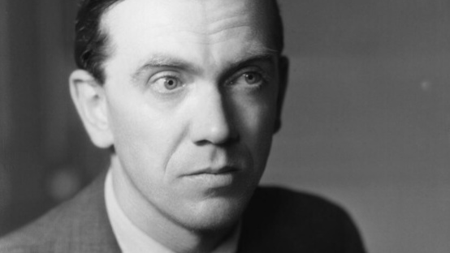
GRAHAM GREEN RULES OF WRITING

Slide 22
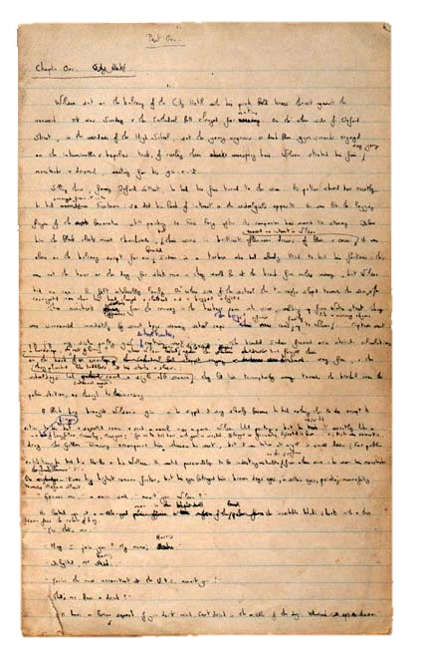
“Over twenty years I have probably averaged five hundred words a day for five days a week. I can produce a novel in a year, and that allows time for revision and the correction of the typescript.
I have always been very methodical, and when my quota of work is done, I break off, even in the middle of a scene.” Graham Greene - The End of the Affair 1951
WILLIAMLANDAY.COM., 2021. How Writers Write: Graham Greene | William Landay [viewed 17 March 2021]. Available from: https://www.williamlanday.com/2009/07/08/how-writers-write-graham-greene/
‌

Slide 23
DIDION, J., 2021. Joan Didion: Why I Write [viewed 28 June 2023]. Available from: https://lithub.com/joan-didion-why-i-write/
LITERARYDEVICES.NET., 2020. Figure of Speech - Examples and Definition of Figure of Speech [viewed 17 March 2021]. Available from: https://literarydevices.net/figure-of-speech/
‌
ORWELL, G., 1946. Politics and the English Language. Available from: http://www.public-library.uk/ebooks/72/30.pdf
‌
ORWELLFOUNDATION.COM., 2021. The Orwell Foundation [viewed 17 March 2021]. Available from: https://www.orwellfoundation.com/
‌
TEMPLE, E., 2019. ‘You Don’t Know Anything.’ And Other Writing Advice from Toni Morrison [viewed 28 June 2023]. Available from: https://lithub.com/you-dont-know-anything-and-other-writing-advice-from-toni-morrison/
WRITINGCLASSES.COM., 2021. George Orwell: 6 Questions/6 Rules - Gotham Writers Workshop [viewed 17 March 2021]. Available from: https://www.writingclasses.com/toolbox/tips-masters/george-orwell-6-questions-6-rules
WILLIAMLANDAY.COM., 2021. How Writers Write: Graham Greene | William Landay [viewed 17 March 2021]. Available from: https://www.williamlanday.com/2009/07/08/how-writers-write-graham-greene/
‌

Slide 24
Thank you

